Slide 1
Behavioural training for consultants
Dr. Siân Jaggar
Consultant Anaesthetist
Royal Brompton Hospital

Slide 2
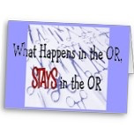
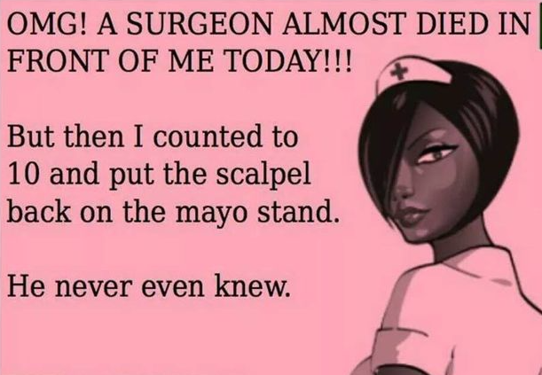
What is the problem?
General discontent
Staffing issues (including theatres)
CQC report
‘…alarming culture within the NHS … 1 in 4 staff have reported B&H from colleagues or managers … safety is being jeopardised by dysfunctional rift ….’

Slide 3
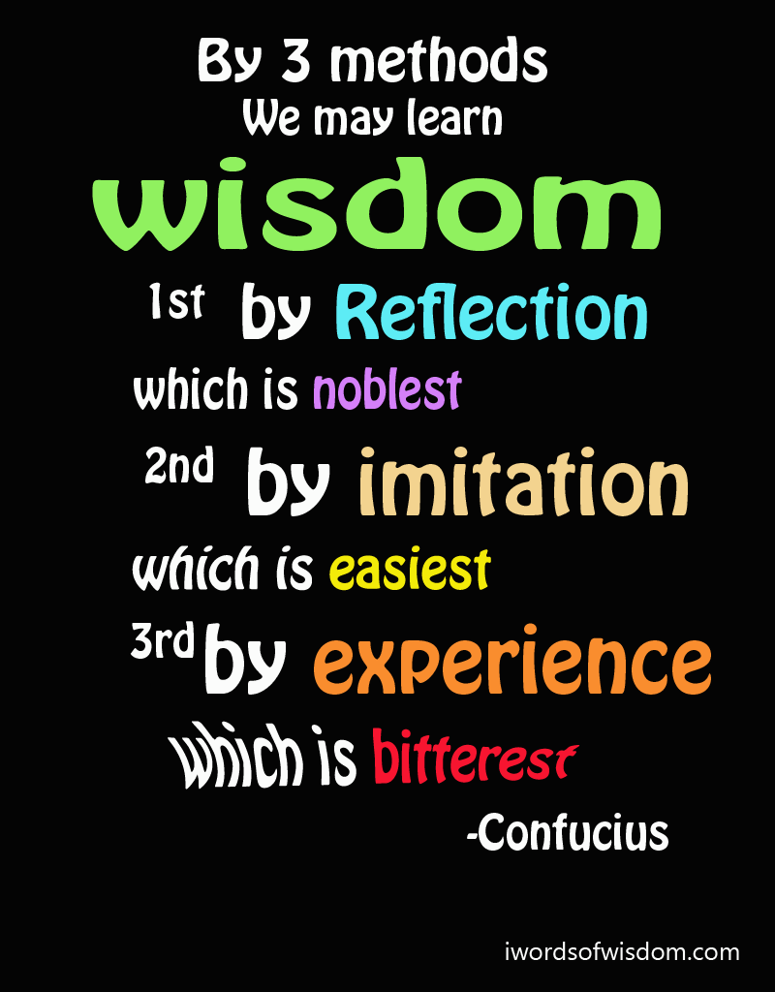
What we did at RBHT
B&H sessions in theatres
HR provision
B&H support service provision
Theatre staff member
Different outcomes
Who asks makes a difference
‘CONSULTANTS SHOULD BE MADE TO DO THIS’

Slide 4
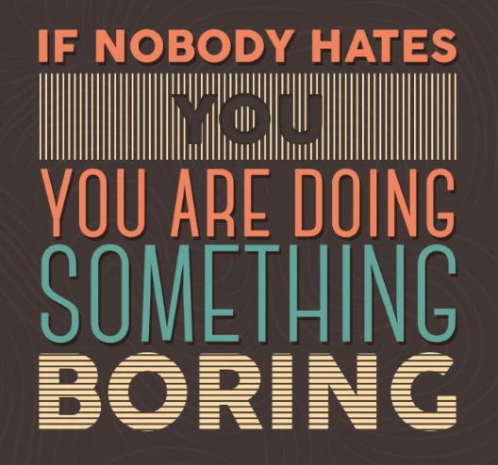
What we did next
Consultant sessions
Mandated by medical director
Require Survey Monkey F/U
All run by 1 consultant (me)
Small specialist Trust = possible
F/U after 2-3 months

Slide 5
Results
90 consultants attended sessions so far
Follow up Survey Monkey
59 responses so far (of potential 85)
10 questions
Q1-4 = definitions
Q5-10 = reflections on self & others
Average time spent 12 minutes
Notes:
Very proud that my hospital is happy for me to present the data – rather than keep hidden
Recognition is the 1st step to change – something we all need to consider

Slide 6
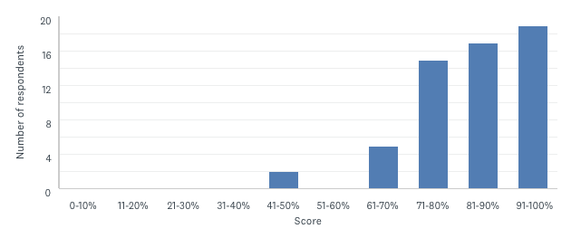
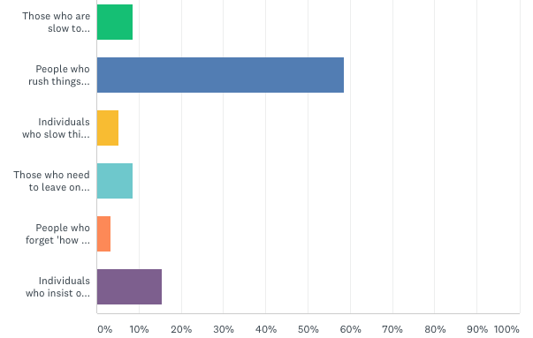
General findings
Knowledge – OK
Definitions
Skills – not assessed
Behaviour occurrence
Required self-reflection
This will be fed-back
Consultants
Managers
AHPs
Notes:
Mostly people understood facts (88%)
Individuals most disliked working with those who rush things, but almost 1/5 found individuals who insisted in checking everything most irritating

Slide 7
Findings – extreme behaviours
When did you last observe B&H or undermining? | Number (n=40)
Last few weeks | 10
Last few months | 10
Last few years | 10
Don’t know | 6
Never | 4
When did you last undermine someone? (n=32)
Never 46%
I try to avoid 34%
In last few months 9%
In last few years 9%
Who are you most likely to treat poorly? (n=59)
Other consultants 40%
Managers 29%
Junior medical staff 19%
AHPs 5%
What did you do about it? | Number (n=21)
Nothing | 4
Someone else reported it | 2
Reported it | 5
Spoke later to individual | 2
Intervened | 8
Notes:
Junior medical staff treatment – twice as likely to treat those from other teams worse compared to their own team

Slide 8
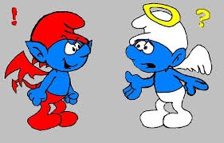
Findings – bad behaviour
How often do you observe bad behaviour? | Number (n=37)
Every day | 5
Every week | 15
Every month | 5
Occasionally | 7
Never | 4
When did you last adversely affect someone?
Never 24
? How perceived 3
Not reward bad care 3
In last few years 2
What did you do about it? | Number (n=23)
Nothing | 5
Individual discussion | 10
Variable | 8
Notes:
People see bad behaviour, but don’t consider they are involved!

Slide 9
Findings – behaviours
What makes you behave badly? | Numbers (n=59)
Poor team engagement / incompetence / inefficiency | 19
Bullying / poor behaviour by others | 10
Work overload / sleep deprivation / stress | 19
Management inconsistency | 2
Nothing | 5
What you Trust do to help you?
Show appreciation = 10
Provide more personnel = 8
Stress management programmes = 7
Improved facilities (time/food/IT) = 3
Consistent management = 5
More teaching/focus on behaviour = 2
Its my responsibility
Not up to the Trust
(n=11)
Notes:
Tendency to notice problems rather than consider solutions

Slide 10
Summary
Consultants are aware bad behaviour occurs in their work environment
They think it is others behaviour that is an issue
Consultants believe they are most likely to treat other consultants poorly
2x as likely to treat juniors from other teams badly
Open discussion of behaviour should help guide local management

